Slide 1
Decision trees

Slide 2
Decision trees
Originally invented for concept learning (two-class classification) over discrete features
  But later it was extended to more classes
  And also to continuous features (here: “attributes”)
Also closely related to the learning of logical formulas
It has no strict mathematical background, it is based on Occam’s heuristic – a simpler explanation usually generalizes better
It seeks to create a compact and consistent representation for the training data
  It was shown (later) that compression is closely related to learning, so creating a compact representation is indeed a good heuristic
The representation will be a decision tree
  We will try to build the smallest possible decision tree

Slide 3
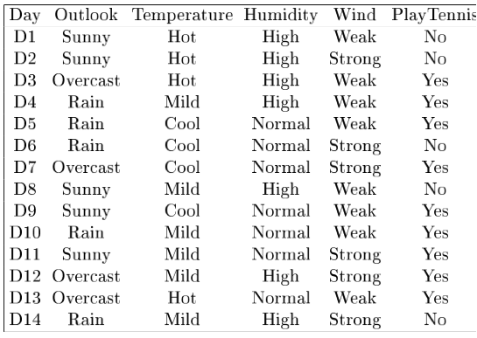
Representing the training data with a logical formula
Example task:

Slide 4
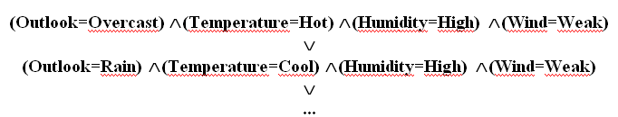
Representation by a logical formula
We can represent each Yes row by a conjuction:
And we can connect these by disjuctions:
If the table contains no contradicting examples, then the above formula is true for all positive examples, and negative for all negative examples → it is consistent with the training data
We also want the formula to be as small as possible, as this is our heuristics for good generalization
  The same truth table may be represented by many logical formulas! How can we find a smallest one?

Slide 5


Reducing the logical formula
How can we reduce the size of the above formula?
We can remove unnecessary evaluations:
is equivalent to
When two or more rows contain the same sub-formula, we should avoid evaluating them two or more times:
The idea of joint evaluation leads to the decision tree representation

Slide 6
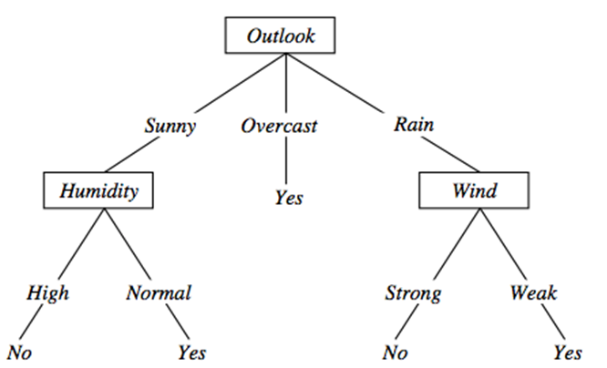
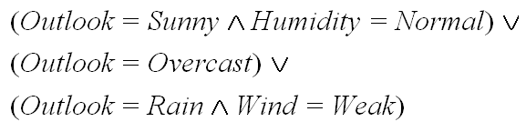
Representation by a decision tree
This is how a decision tree look like:
  Each path from the root to a yes leaf
  corresponds to a conjunction
  The whole tree represents the
  disjunction of these paths
So the above tree represents the
logical formula:
You can also check that the above formula is consistent with the table, however, it is much smaller than the disjunction of conjunctions we created earlier

Slide 7
Construction of decision trees from data
We was how the decision tree classifies an example
We saw that a decision tree corresponds to a logical formula
  So, instead of learning formulas, we can learn decision trees
But how can we learn decision trees?
  That is, given the table with the examples, how can we automatically create a decision tree?
  It should be consistent with the examples
  And we also seek to build a small tree
Next, we present the ID3 tree building algorithm of Quinlan (1986)
  It builds the tree recursively, from the root to the leaves
  It seeks to build a small tree by a greedy attribute-picking strategy
  It has several extented versions (see later)

Slide 8
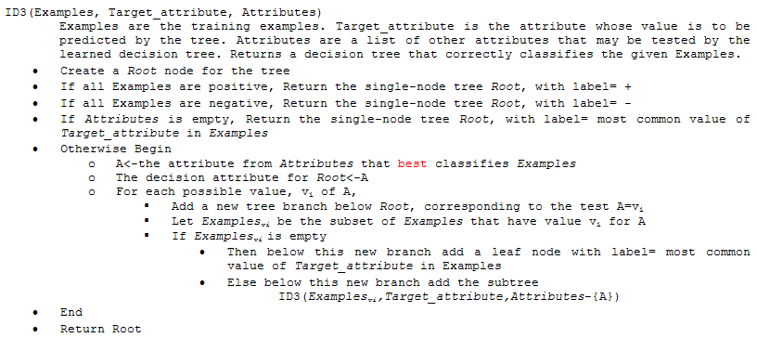
The ID3 algorithm

Slide 9
The ID3 algorithm - Summary
We select an attribute for each node (we will discuss later how)
We create branches according to the possible values of this attribute
  We also divide the data items according to the actual value of this attribute
We recursively repeat the algorithm for each branch and the corresponding data items
Stopping criterions:
  All the data in the branch are positive – create a leaf with label positive
  All the data in the branch are negative – create a leaf with label negative
  No data in the branch – create a leaf with the most common label at the parent node
  No more attributes to test (this means that the data in this branch is contradictory ) – create a leaf with the most common label

Slide 10
How to select the attribute for a node?
We want to build a small (shallow) tree
Building stops when the data in all branches is “clean” – that is, the positive and negative examples do not mix
Our heuristics will be to chose the attribute that gives the largest decrease in the “impurity” of the data
There are many possible ways to formally define the impurity
  One possibility is to use the notion of entropy
We will define the information gain as the expected reduction of entropy
At each node, we will calculate the information gain for each attribute, and select the one that gives the largest information gain

Slide 11
Entropy (for 2 classes)
Let S be a set of examples
p₊ is the ratio of positive examples (0≤ p₊ ≤1)
p ₋ is the ratio of negative examples (0≤ p₋ ≤1)
Entropy (S) ≡ – p₊ log₂ p₊ – p–log₂ p– [note: 0 log₂0 = 0]
Example:
Entropy ([14+, 0–]) = – 14/14 log₂ (14/14) – 0 log₂ (0) = 0
Entropy ([9+, 5–]) = – 9/14 log₂ (9/14) – 5/14 log₂ (5/14) = 0.94
Entropy ([7+, 7– ]) = – 7/14 log₂ (7/14) – 7/14 log₂ (7/14) = 1.0

Slide 12
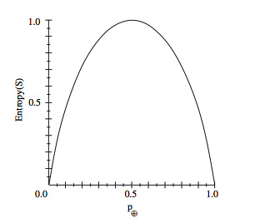
Entropy (for 2 classes)
In general, the shape of the entropy curve looks like
Note that p₊ = 1- p –
The entropy become maximal (1.0) when p₊ = 0.5 and p₋ = 0.5
so that the positive and negative examples are maximally mixed
This is why it can be used as a measure of “impurity”

Slide 13
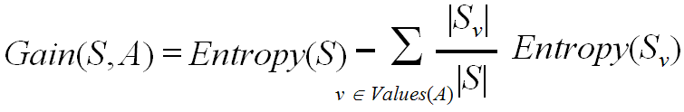
The information gain
The information gain is the expected reduction of entropy caused by partitioning the data according to the values of the given attribute
Where v are the possible values of attribute A, and |S_{v} | is the number of examples in the branch that belongs to value v
At each node with the given S subset of data, we calculate this gain for all attributes A, and select the one that maximizes the above gain

Slide 14
Main properties of ID3
It was invented for discrete features (involving binary features)
It does not restrict the hypothesis space in advance (has no “modeling assumption”) , so it can create a consistent decision tree for any dataset that contains no contradicting samples
It has a “preference bias”, that is, it tries to put the attributes with high information gain close to the root
The decision for the best attribute is greedy, and there is no backtracking, so the resulting tree is not guaranteed to be optimal (the smallest possible)
The result is easily interpretable for humans (e.g. the tree can be directly displayed or converted to a set of IF-THEN rules)
Not too sensitive to noise (erroneous labels), as the decision for the attributes (the entropy measure) is statistical (uses all data in the branch)
  Though it becomes more and more sensitive as we get closer to the leaves

Slide 15
The pruning of decision trees
As we move down in the decision tree, fewer and fewer data samples remain in each branch
  We make decisions based on fewer and fewer samples, so individual samples have a larger and larger influence
  The chance of making a wrong decision due to e.g. a noisy (incorrectly labeled) example increases
If the data contains no mistakes (e.g. incorrectly labeled samples), the tree building stops only when a perfect decision tree is build for the training data (training error is 0%)
  This tree is likely to be overly complex, with many of the leaves assigned based on only a couple of examples
  It will quite probably overfit the training data
These are the two main reasons for pruning the tree

Slide 16
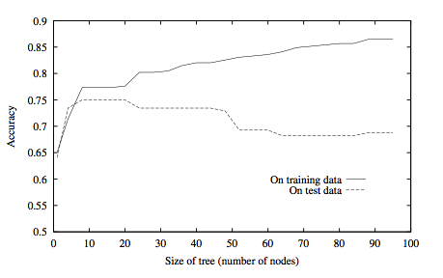
Overfitting example

Slide 17
The pruning of decision trees
There are two main approaches to reduce overfitting
In both cases we reduce the size of the tree
1. approach: early stopping of tree building
  E.g. do not split a node further when the number of examples in the given branch is below a given limit
  Assign a leaf corresponding to the majority of labels
2. approach: allow the tree to build fully, then post-prune the tree
  Try to prune each node by replacing it by a leaf that is labeled according to the majority of labels
  Measure the effectiveness of pruning on a validation set
  Remove the node that gives the largest increase in the classification accuracy on the validation set
  Stop pruning when there is no increase in accuracy

Slide 18
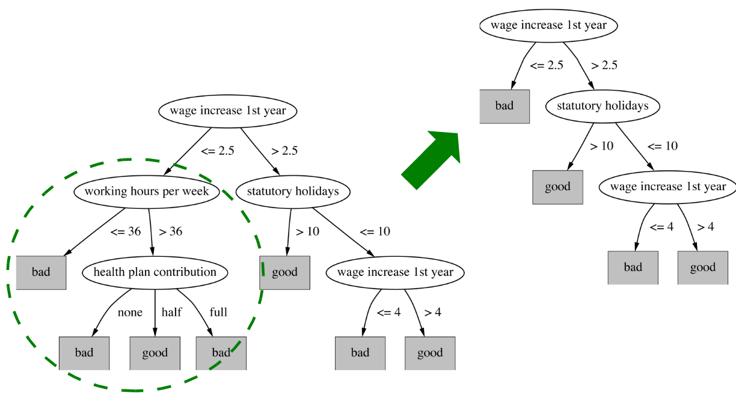
Pruning example

Slide 19
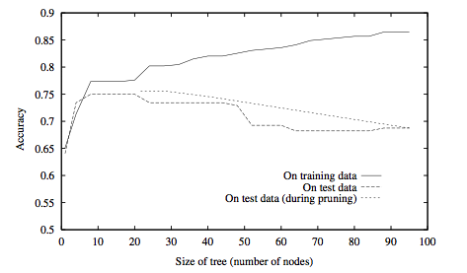
Post-pruning example

Slide 20
Extensions of decision trees
Extension to continuous attributes
Alternative measures of information gain
Handling training examples with missing attributes
Handling examples with different costs
Most of these improvements are present in the most popular implementation of decision trees called C4.5 (Quinlan, 1993)

Slide 21
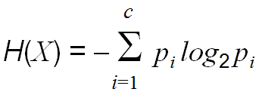
Extension to more classes
Fortunately, entropy is defined for more classes
  Let X be a discrete random variable with c possible values. Then its entropy is defined as
  With this, we can easily modify the information gain function to work for more classes. The other parts of the algorithm require only minimal modifications
Extension to probability estimation
  Remember that the (pruned) tree assigns labels to leaves based on the majority of the samples in the given branch
  We can easily modify this to return probability estimates for each class, estimated as the ratio of the samples belonging to the given task within the branch

Slide 22
Extension to continuous attributes
We can discretize a continuous variable using thresholds like:
(Temperature>10)∧(Temperature<30)
This way the decision tree building algorithm works just as before
  But how can we select the thresholds automatically?
Example for the earlier training data set – with continuous temperature values
  Let’s order the examples according to the values of the attribute we want to discretize, and the target label:
  Candidate thresholds: the average of the values where the label changes
  We add (Temperature<54), (Temperature>54), …to the attribute set
  We let the information gain select from these during tree building

Slide 23
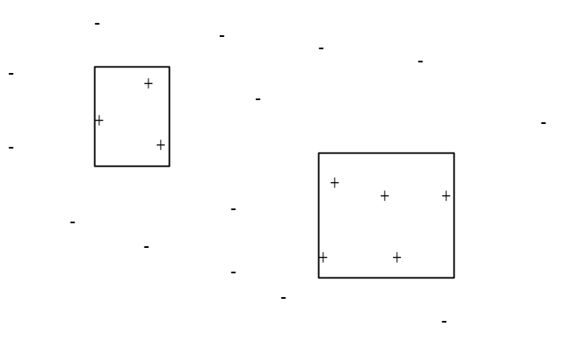
Extension to continuous attributes
In the case of continuous attributes the decision tree represents the classes with a union of rectangles that are parallel to the axes:
So theoretically it can approximate regions with arbitrary shape (including disconnected regions)
  However, it is not really efficient
  When all the features are continuous, I would recommend the use of some classifier directly designed for continuous space (e.g. GMM)
  However, it is quite good for discrete features or mixed features

Slide 24
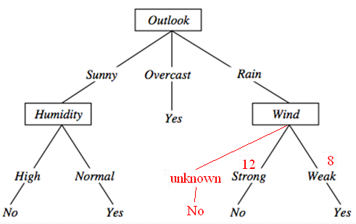
Extension to missing features
What can we do if a feature is missing during testing?
  During tree building, we count the number
  of occurrences for each branch
  After building the tree, we create an additional
  “unknown” path, and label it with the label of
  the most frequent path
What can we do if there are missing features
during training (tree building)?
  Let’s build the tree without using the samples that have missing features (we assume that these correspond to the majority of the samples)
  From the occurrences of each branch we can create probability estimates (similarly to the method shown above)
  We assign the most probable value to each missing feature, then we update the tree by using also the samples with the missing features
There are many other methods for this – more or less sophisticated

Slide 25
Refining the information gain
The information gain fwill prefer attributes that have many values
It will cause problems when some attributes have many more possible values than others
  Extreme example: consider the playTennis function with the Date added as an attribute to the training samples
  It would be selected as the root, resulting in a very broad tree that creates too many small branches with very few data in each branch
  This tree would strongly overfit the training data, and generalize poorly to the test data
We would like to modify the information gain so that it penalizes such attributes

Slide 26
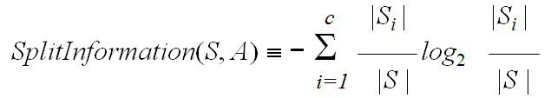
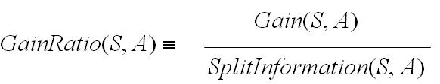
Gain ratio
We introduce SplitInformation:
It measures the entropy of the partitioning of S. More subsets and more uniform division among the subsets results in higher values
  Example: SplitInformation for n equally distributed classes:
  It increases as n increases
We introduce a new attribute selection metric as:
GainRatio penalizes attributes that create many small subsets

Slide 27
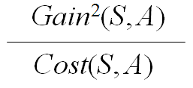
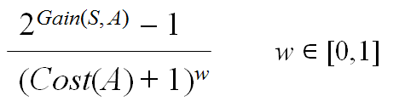
Attributes with different costs
There might be applications where the different features might have different costs (e.g. a medical application)
So during tree building we would like to avoid using the high-cost attributes, or delay their usage closer to the leaves (so that their evaluation would be required only for few test examples)
We can modify the gain function to take the cost into account:
Or

Slide 28
Conversion to rules
The learnt decision tree can be converted into a hierarchy of
IF-THEN rules
This has two main advantages
1. This is useful when human readibility, intrepretability is important
2. We can also perform the pruning on the rules instead of the tree, and this is more flexible than tree pruning:
  Each distinct path through the tree will correspond to a distinct rule
  So, we can prune just one path without pruning the whole node
  The paths do not require to preserve the order of the attributes, so we can prune attributes from a rule that are closer to the root

Slide 29

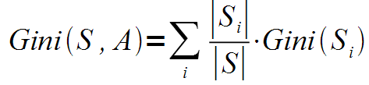
Classification and regression trees (CART)
This is the other most popular implementation besides C4.5
The biggest difference is that instead of entropy, is uses the Gini index as the impurity measure
  Gini impurity is a measure of how often a randomly chosen element from the set would be incorrectly labeled if it was randomly labeled according to the distribution of labels in the subset.
And the average Gini index is calculated as
  Finally, the Gini gain is calculated similarly to the information gain
Other difference: it can use multivariate decisions
  Decisions that are built on more attributes, not just one

Slide 30
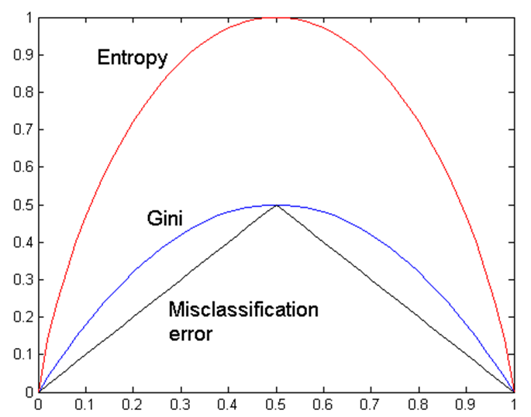
The classification error splitting criterion
Another popular splitting criterion
  It measures of how often a randomly chosen element from the set would be incorrectly labeled if it was labeled according to the maximum a posteriori decision rule (i.e. the Bayes decision rule)
A Comparison of the Entropy, Gini
and classification error criteria for
the case of two classes
  The curves have similar shapes,
  and peak at 0.5

Slide 31

Regression trees
How to use decision trees for regression, that is, when the target labels are not classes, but numeric values?
Modifications required to obtain regression trees:
Leaf nodes will return the average value of all instances in this leaf
Splitting criterion:
  We minimize the variance of the values within each subset S_{i}
  The splitting criterion will be the standard deviation reduction (remember that we have no class labels!)
Early stopping of tree building (don’t want single points in each leaf)
  Lower bound on the standard deviation in each node
  Lower bound on the number of examples in each node
Pruning: with numeric error measures like the mean squared error

Slide 32
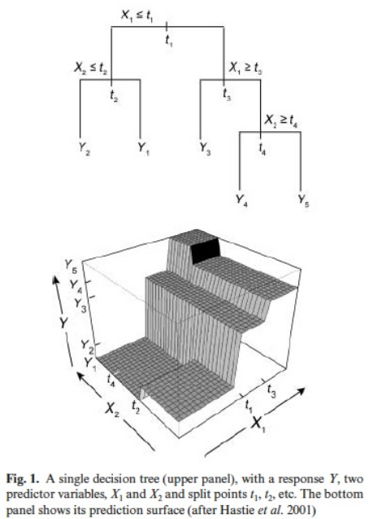

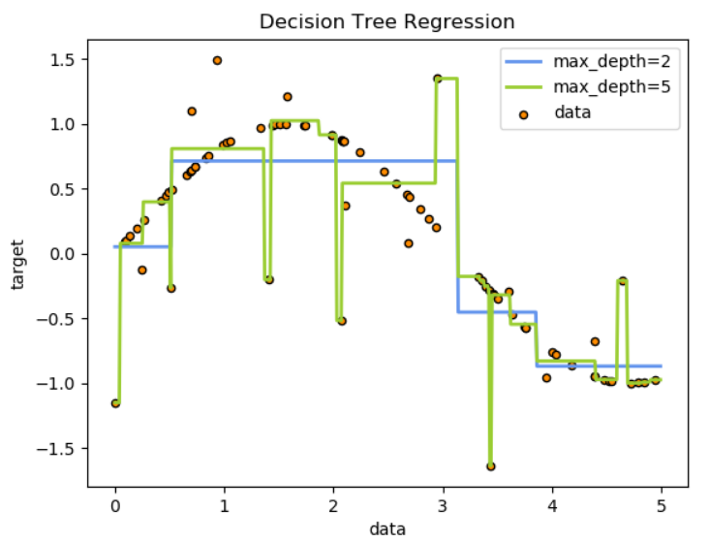
Regression trees

Slide 33
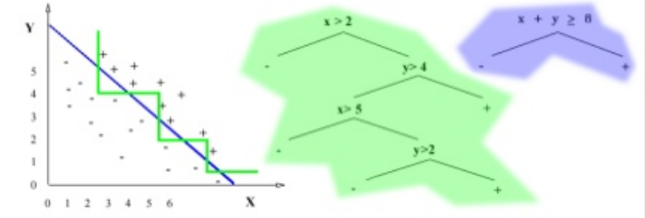
Multivariate decision trees
The the case of continuous features, applying decisions based one exaclty one attribute results in decision boundaries that are built from lines parallel to the axes (see green curve and decision tree)
We could obtain a much smaller tree if we could create multivariate decisions (see blue curve and tree)

Slide 34
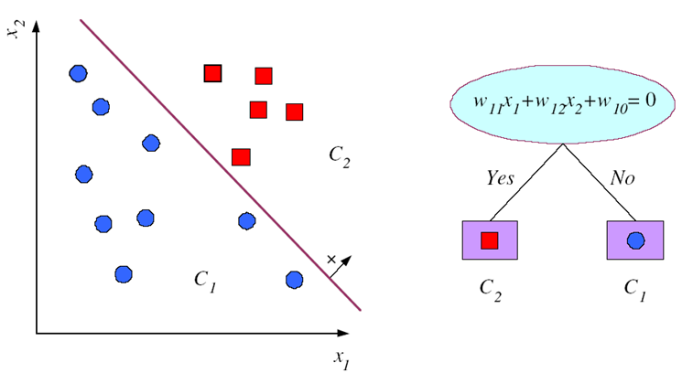
Multivariate decision trees
These are the so-called multivariate decision trees
  The decisions are formulated as weighted linear combinations of the attributes (see figure)
  The decision surfaces are still built from lines, but not necessarily lines parallel with the axes
Unfortunately, the tree-building procedure becomes much more complicated
  We have to examine all
  possible feature combinations
  For more details, see:
  http://legacydirs.umiacs.umd.edu/~salzberg/
  docs/murthy_thesis/survey/node11.html

